Slide 1

Capstone: The Movie
A Non-Technical Presentation By Evan Jacobs

Slide 2

I Have a Bad Feeling About This
You don’t know how you know. Maybe it’s seeing a trailer. Maybe you just heard about the cast. Maybe you just saw the title.
You don’t know how you know; you just know: This movie will suck.
You don’t need to be Nostradamus to know Michael Bay will never win the Oscar for best director.
But can we teach a computer not to need to be Nostradamus?

Slide 3

I Didn’t Cheat
We want to predict scores on the amazing website Metacritic.
In order to train a computer to predict on an upcoming movie, we can only use what we will expect to know about a movie before it comes out. (Also we can only use what we can find on the internet)
Given time constraints, this left us with title, director, writer, actors (first four), production company, rating, and runtime.

Slide 4

It’s Working! It’s Working!
We can teach a computer to be Nostradamus, but a version of Nostradamus who can actually predict things.
With a high level of confidence, we can predict whether a movie will score well and even how well it will score on Metacritic, given only some of the initial production information.

Slide 5

I Surrender! What More do you Want?
There is still a lot of data that needs to be collected. We could get casting directors, cinematographers, budget, stunt doubles, best boy grips, etc.
We also had a fair amount of holes in the data we haven’t yet had time to fill, as well as several different methods for training the computer.

Slide 6

We Can Do Better. We’re Gonna Do Something Else
Hopefully, given time (and cash donations), we will be able not only to predict Metacritic score, but also box offices revenue and awards.
Finally, one of the hopes of this project will be to compile a large, comprehensive, yet still wieldy open-source databases of movies on the internet to be updated for as long as I feel like it, which could even be as much as weeks!

Slide 7

Hey Thanks!
Points if you can identify all of these movies.

Slide 8
Capstone: The Movie
Let’s Get Technical

Slide 9
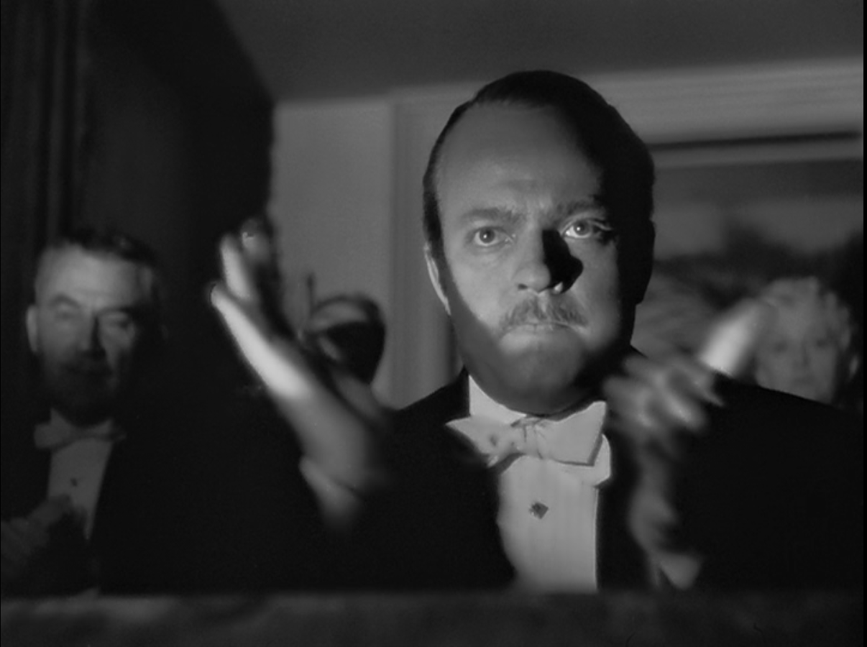
COMING ATTRACTIONS

Slide 10
I Have a Bad Feeling About This
You don’t know how you know. Maybe it’s seeing a trailer. Maybe you just heard about the cast. Maybe you just saw the title.
You don’t know how you know; you just know: This movie will suck.
You don’t need to be Nostradamus to know Michael Bay will never win the Oscar for best director.
But can we teach a computer not to need to be Nostradamus?

Slide 11
I Didn’t Cheat
We want to predict scores on the amazing website Metacritic.
In order to train a computer to predict on an upcoming movie, we can only use what we will expect to know about a movie before it comes out. (Also we can only use what we can find on the internet)
Given time constraints, this left us with title, director, writer, actors (first four), production company, rating, and runtime.

Slide 12

I HAVE DETAILED FILES

Slide 13
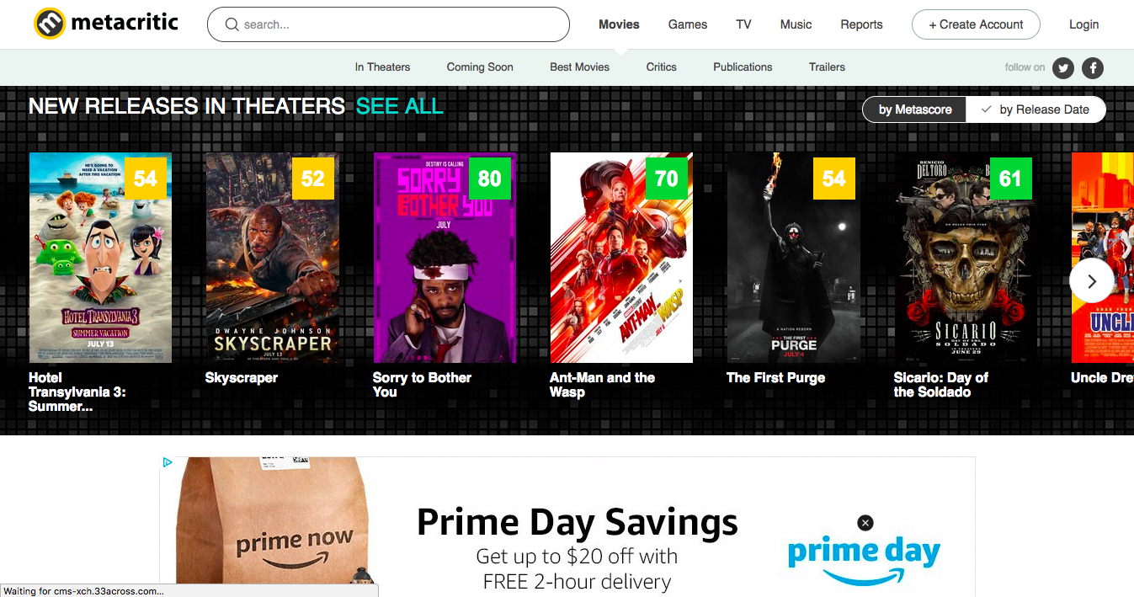
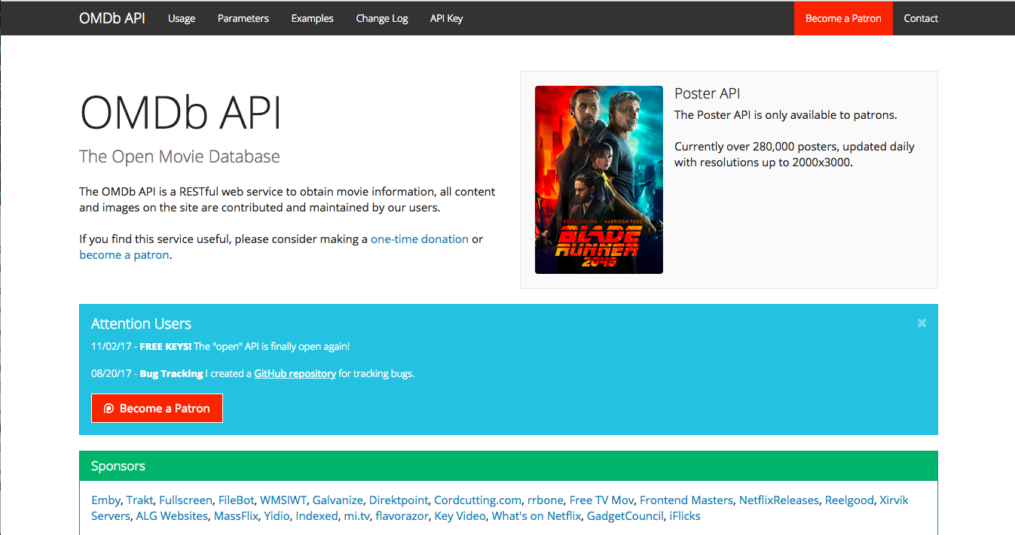
Data Brought to us by the Bothan Spies
We first took movie titles from Wikipedia and combined it with an existing database (https://grouplens.org/datasets/movielens/latest/).
Then we ran it through the OMDB API to get information about each movie.

Slide 14
So You Have Come Here for Information
We had lots of different data points, but decided to collect the following to predict on:
- Actors (first four) - Director - Genre - Production
- Rated - Release Date - Runtime - Title - Writer
We also collected the following to be used as targets:
- Metascore - Box Office Revenue

Slide 15

THE INFORMATION IS IN THE SAFE

Slide 16

Explorer, do you Read?
Because of the size of the database, we didn't spend much time imputing missing values.

Slide 17
All Clean. All Clean.
We started with 43837 separate movies and pared them down to the list of only ones where we had a Metascore, leaving us with 10192 movies. We also did the following:
Built several functions to clean the data.
Dropped as many null values as we could find.
Then we did some data exploration!

Slide 18
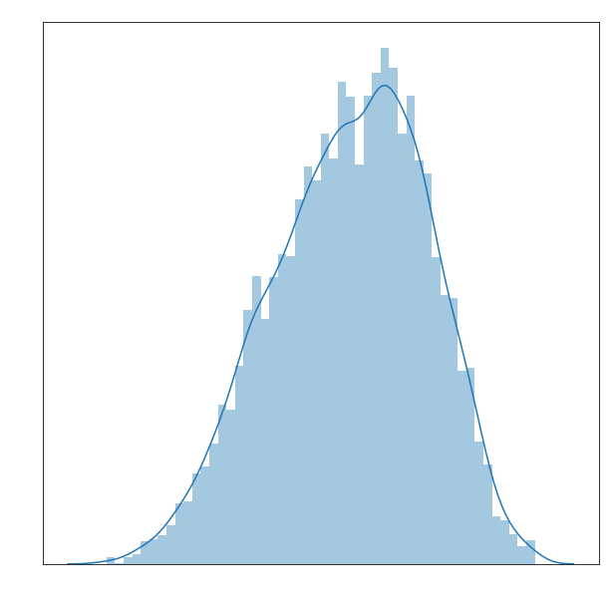
Below average!
Below average!
Apparently Metacritic’s average movie score is around a 65. Considering the website is a score aggregator and interpreter, this was surprising.

Slide 19
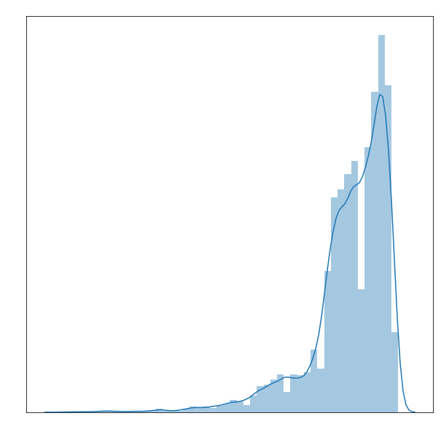
Time is the Fire in
Which we Burn
Most of our movies come from after the year 1999, when Metacritic started.

Slide 20
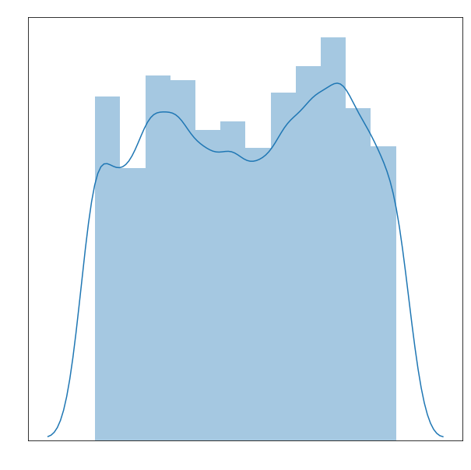
Month of the Year
Our distribution of months show us that movies tend to come out in the summer and holiday season.

Slide 21
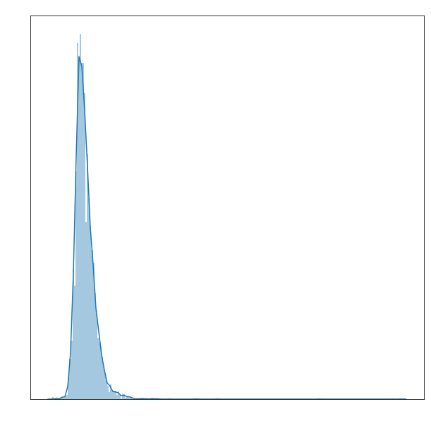
No, No, I Like it
This Length
Our distribution of movie runtimes. Notice that this graph is incredibly skewed by one movie: Out 1, a 13 hour film from 1971 (https://en.wikipedia.org/wiki/Out_1).

Slide 22
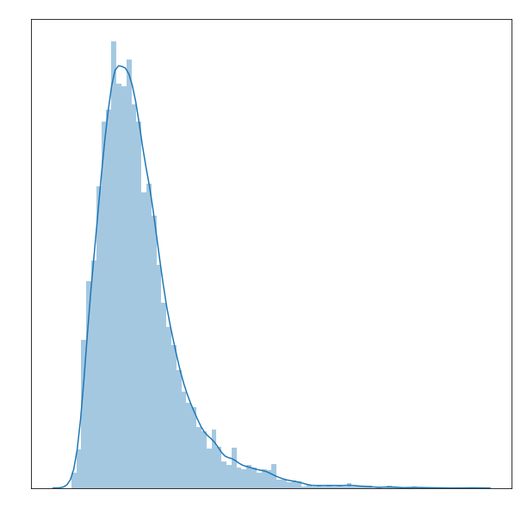
Your Name Only. It's
Such a Very Long Name..
Our distribution of movie title lengths. Most movies are content to be about 17 letters long.

Slide 23
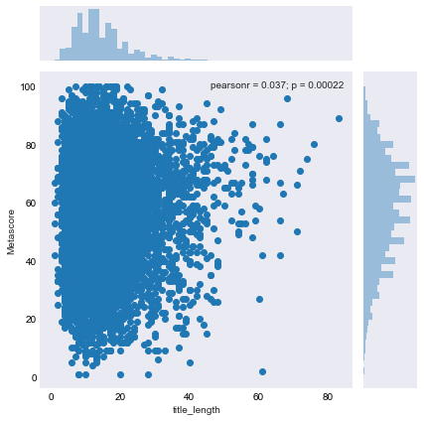
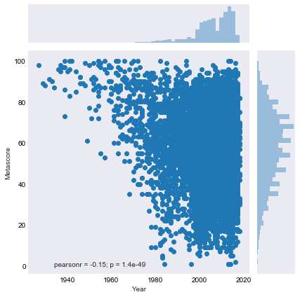
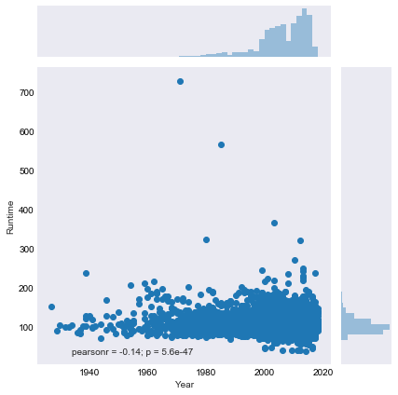
It’s Not on Any of the Charts
Title Length by Metascore
Metascore by Year
Runtime by Year

Slide 24

WE CALL THEM ENGINEERS

Slide 25
I Have Sampled Every Language
Most of our most important data was categorical. In particular we had the director, the actors, and the writer, as well as the title, the rating, and the production company. Thus, we used natural language processing in the following ways:
We took out each name, rating, and company, and counted its occurrence, removing rows with only one or two occurrences.
We took the movie titles and counted occurrence of words using length one and two n-grams.

Slide 26
Anything. Pick a Feature
After initial testing, we decided to weight our columns with the the average Metascores for directors, writers, and actors. Eventually we saved six dataframes to test on:
Three dataframes with deleting columns that had one value or less: one with directors weighted, one with directors and actors weighted, and one with directors, actors, and writers weighted.
Three dataframes with deleting columns that had two values or less: one with directors weighted, one with directors and actors weighted, and one with directors, actors, and writers weighted.

Slide 27
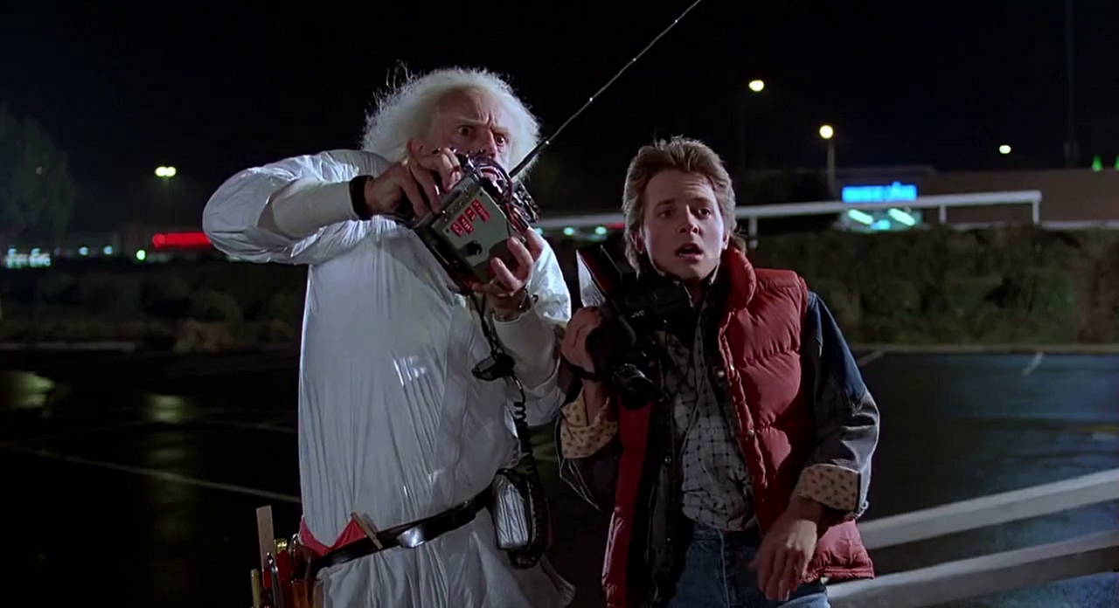
PLEASE EXCUSE THE CRUDITY OF THIS MODEL

Slide 28
Commit This List of Periodicals to Memory
Guide to the models:
1 df 2 = directors and actors weighted, , deleted columns with 1 or fewer terms
2 df 2 = directors and actors weighted, deleted columns with 1 or fewer terms
3 df 2 = directors and actors and writers weighted, deleted columns with 1 or fewer terms
1 df 3 = directors and actors weighted, , deleted columns with 2 or fewer terms
2 df 2 = directors and actors weighted, deleted columns with 2 or fewer terms
3 df 2 = directors and actors and writers weighted, deleted columns with 2 or fewer terms

Slide 29
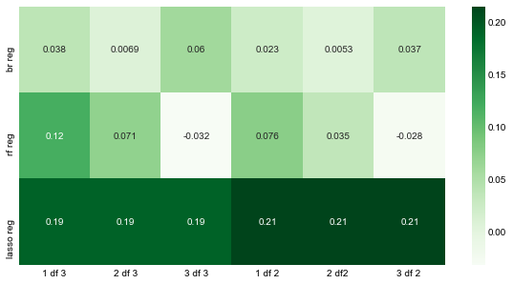
It Makes Me Sad, This Regression

Slide 30
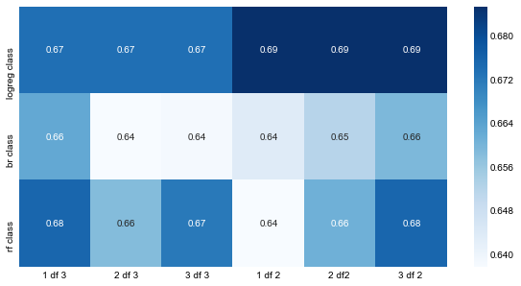
How Classified?

Slide 31
He Can Tune
Using our 3 df 2 dataframe, our best classifier (logreg) cross-validated accuracy:
.6945555555555556 (using C = 10 with an l1 penalty)
And our best cross-validated regression R2 score:
0.21850824761335874 (with auto-chosen alpha)
There is no reason we shouldn't be able to achieve better than this given more time.

Slide 32
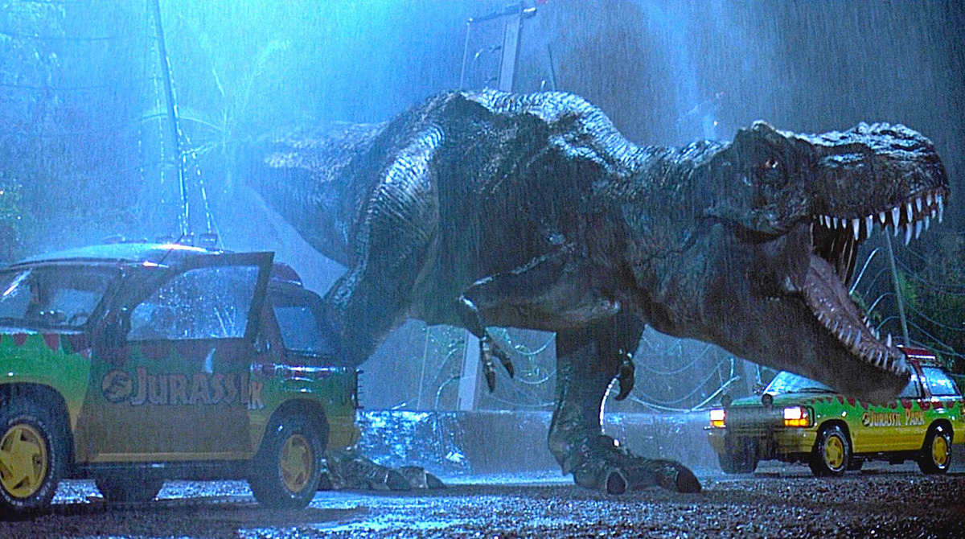
NEXT TIME IT’LL BE FLAWLESS

Slide 33
Nothing Costs More Than Information
Future recommendations are numerous.
Other databases (imdb's. Metacritic's, Box Office Mojo)
More cast/crew (cinematographers, composers, editors, producers)
Impute null values.
Use other scoring metric to apply to Metascore.
Other types of weighting.
More models (passive aggressive classifier, Bayes, neural networks, etc.)

Slide 34
I Will Never Stop Trying
Goals:
Increase accuracy of score prediction/classification
Compile a large, comprehensive database for others to use.
Create a continually updated model to predict upcoming movies and to post those predictions on a social media account or website.
Complete world domination

Slide 35
HASTA LA VISTA, BABY

